Slide 1
Introduction to Probability

Slide 2
Outline
Introduction to Probability Theory
Conditional probability
Representing conditional probabilities using tree Diagram
Bayes’ Theorem

Slide 3
Introduction to Probability Theory
Probability:
The study of randomness and uncertainty
In other words, probability is a numerical measure of chance for the occurrence of an event.
Experiment:
a procedure that yields one of a given set of possible outcomes.
Sample space:
The set of all possible outcomes of an experiment, denoted by S.
Event:
An event is any collection (subset) of outcomes contained in the sample space S.

Slide 4
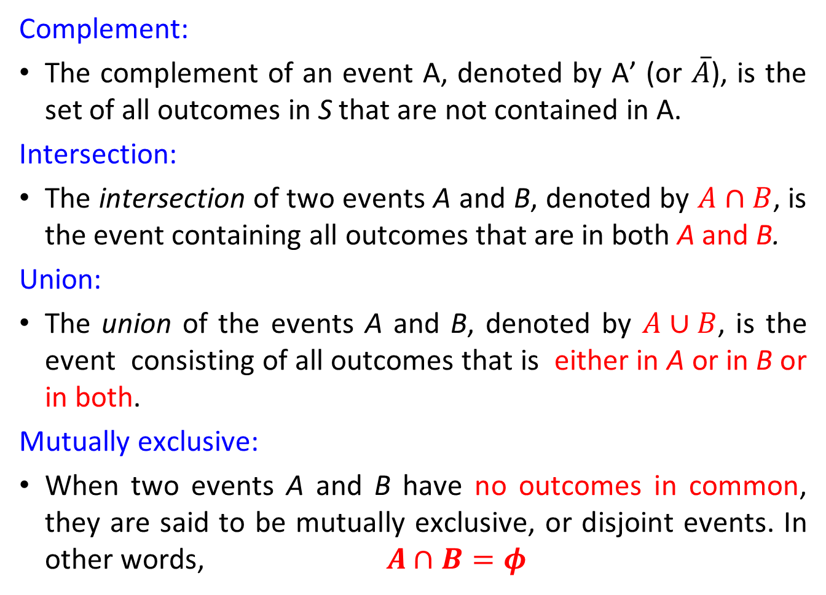
Some Relation from Set Theory
Complement:
The complement of an event A, denoted by A’ (or $\overline{A}$), is the set of all outcomes in S that are not contained in A.
Intersection:
The intersection of two events A and B, denoted by $A∩B$, is the event containing all outcomes that are in both A and B.
Union:
The union of the events A and B, denoted by $A∪B$, is the event consisting of all outcomes that is either in A or in B or in both.
Mutually exclusive:
When two events A and B have no outcomes in common, they are said to be mutually exclusive, or disjoint events. In other words,$A∩B=φ$

Slide 5
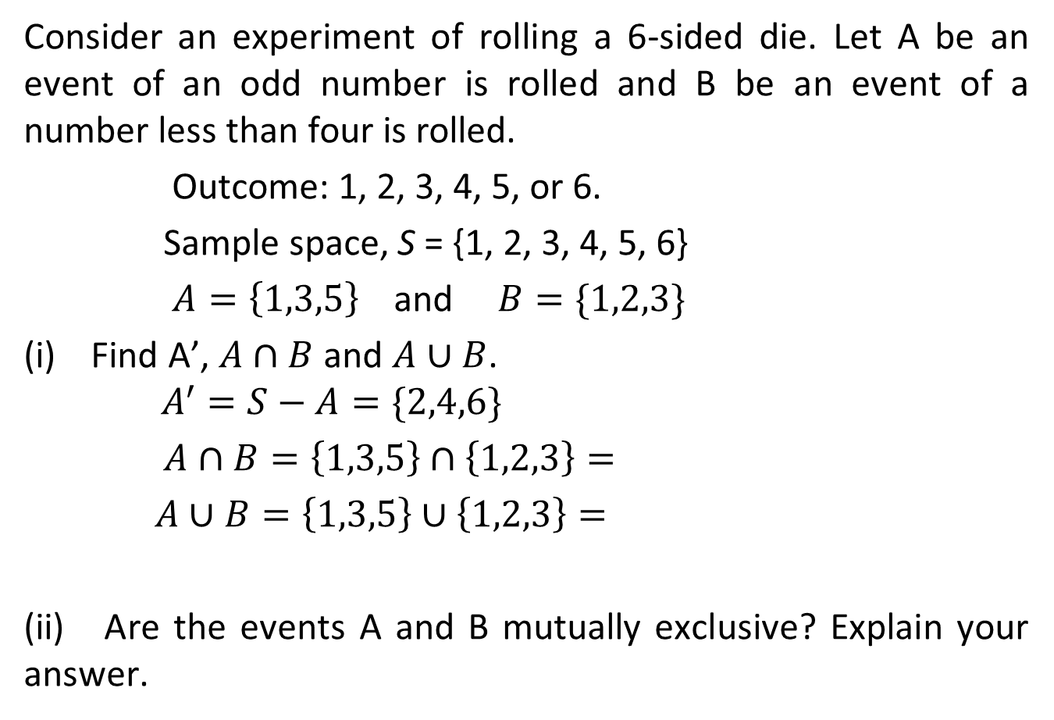
Example 1
Consider an experiment of rolling a 6-sided die. Let A be an event of an odd number is rolled and B be an event of a number less than four is rolled.
Outcome: 1, 2, 3, 4, 5, or 6.
Sample space, S = {1, 2, 3, 4, 5, 6}
$A=\left\{1,3,5\right\}$ and $B=\{1,2,3\}$
(i) Find A’, $A∩B$ and $A∪B$.
$$A^{′}=S−A=\{2,4,6\}$$
$A∩B=\left\{1,3,5\right\}∩\left\{1,2,3\right\}=$
$A∪B=\left\{1,3,5\right\}∪\left\{1,2,3\right\}=$
(ii) Are the events A and B mutually exclusive? Explain your answer.

Slide 6
Example 2
Let A be an event of obtaining ‘at least three heads’ when four coins are tossed. Find A, A’ ,|A| and |A’| .
S = {HHHH, HHHT, HHTH, HTHH, THHH, HHTT, THTH,
THHT, HTTH, HTHT, HHTT, TTTH, TTHT, THTT,
HTTT, TTTT};
|S|= 16
A = {HHHH, HHHT, HHTH, HTHH, THHH};
|A| = 5
A’ = {HHTT, THTH, THHT, HTTH, HTHT, HHTT, TTTH,
TTHT, THTT, HTTT, TTTT};
|A’| = 11

Slide 7
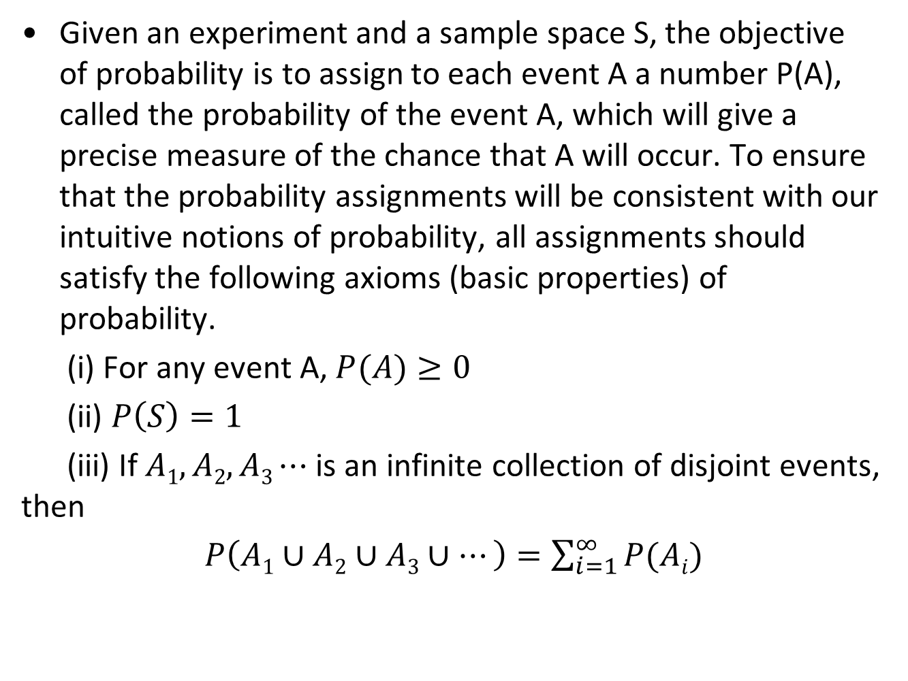
Axioms of Probability
Given an experiment and a sample space S, the objective of probability is to assign to each event A a number P(A), called the probability of the event A, which will give a precise measure of the chance that A will occur. To ensure that the probability assignments will be consistent with our intuitive notions of probability, all assignments should satisfy the following axioms (basic properties) of probability.
(i) For any event A, $P(A)≥0$
(ii) $P\left(S\right)=1$
(iii) If $A1, A2, A3⋯$ is an infinite collection of disjoint events, then
$P\left(A1∪A2∪A3∪⋯\right)=\sum_{i=1}^{∞}{P(Ai)}$

Slide 8
Try This
An experiment has four possible outcomes, A, B, C, D, which are mutually exclusive. Explain why the following assignments of probabilities are not permissible:
(a) P(A) = 0.12 P(B) = 0.23 P(C) =0.15 P(D) = −0.2
(b) P(A) = 1/12 P(B) = 5/12 P(C) = 4/12 P(D) = 7/12

Slide 9
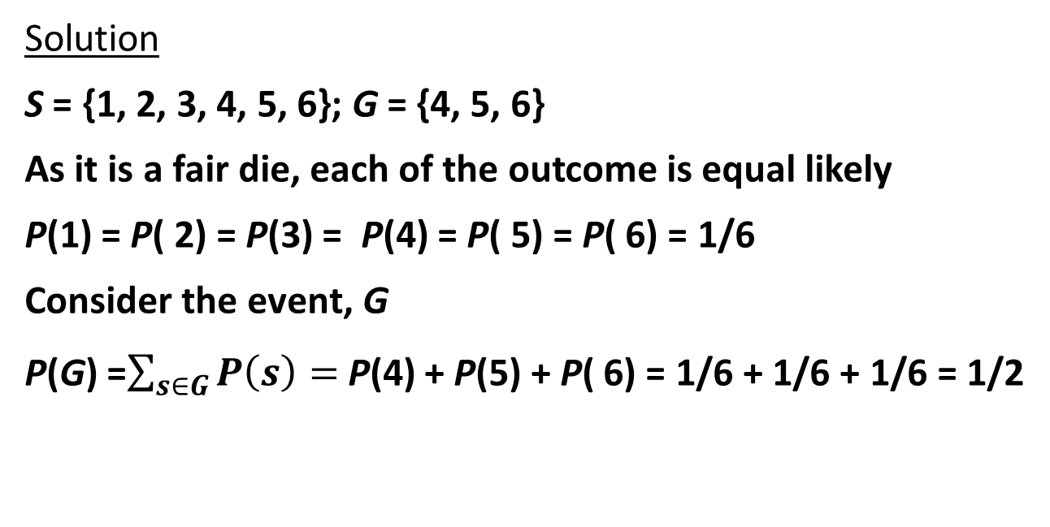
Example 3
In an experiment of rolling a fair die, let G denotes the event that a number greater than 3 has occurred on a single roll of die. Find P(G).
Solution
S = {1, 2, 3, 4, 5, 6}; G = {4, 5, 6}
As it is a fair die, each of the outcome is equal likely
P(1) = P( 2) = P(3) = P(4) = P( 5) = P( 6) = 1/6
Consider the event, G
P(G) =$\sum_{s∈G}{P\left(s\right)=}$ P(4) + P(5) + P( 6) = 1/6 + 1/6 + 1/6 = 1/2

Slide 10
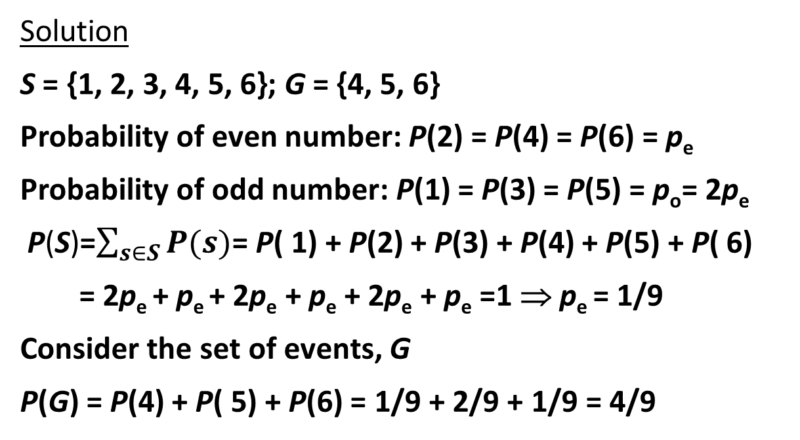
Example 4
A die is loaded in such a way that each odd number is twice as likely to occur as each even number. Find P(G), where G is the event that a number greater than 3 occurs on a single roll of die.
Solution
S = {1, 2, 3, 4, 5, 6}; G = {4, 5, 6}
Probability of even number: P(2) = P(4) = P(6) = p_{e}
Probability of odd number: P(1) = P(3) = P(5) = p_{o}= 2p_{e}
P(S)=$\sum_{s∈S}{P(s)}$= P( 1) + P(2) + P(3) + P(4) + P(5) + P( 6)
= 2p_{e} + p_{e} + 2p_{e} + p_{e} + 2p_{e} + p_{e} =1 ⇒ p_{e} = 1/9
Consider the set of events, G
P(G) = P(4) + P( 5) + P(6) = 1/9 + 2/9 + 1/9 = 4/9

Slide 11
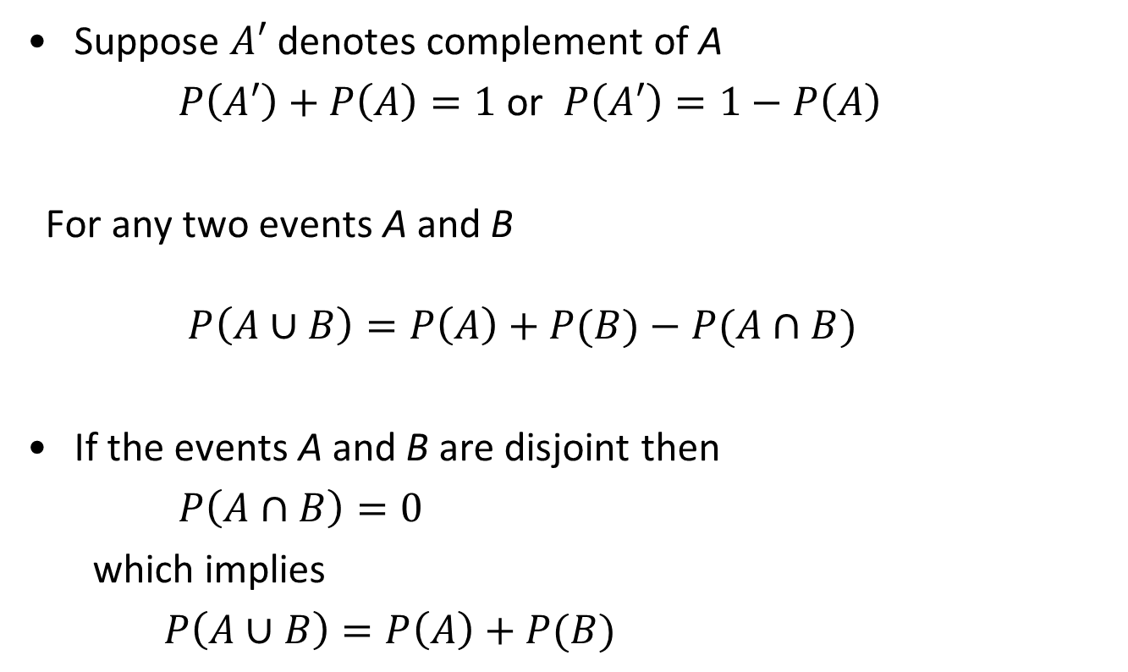
Probabilities of Complements and Unions of Events
Suppose $A′$ denotes complement of A
$P\left(A′\right)+P\left(A\right)=1$ or $P\left(A′\right)=1−P\left(A\right)$
For any two events A and B
$P\left(A∪B\right)=P\left(A\right)+P(B)−P(A∩B)$
If the events A and B are disjoint then
$P\left(A∩B\right)=0$
which implies
$P\left(A∪B\right)=P\left(A\right)+P(B)$

Slide 12
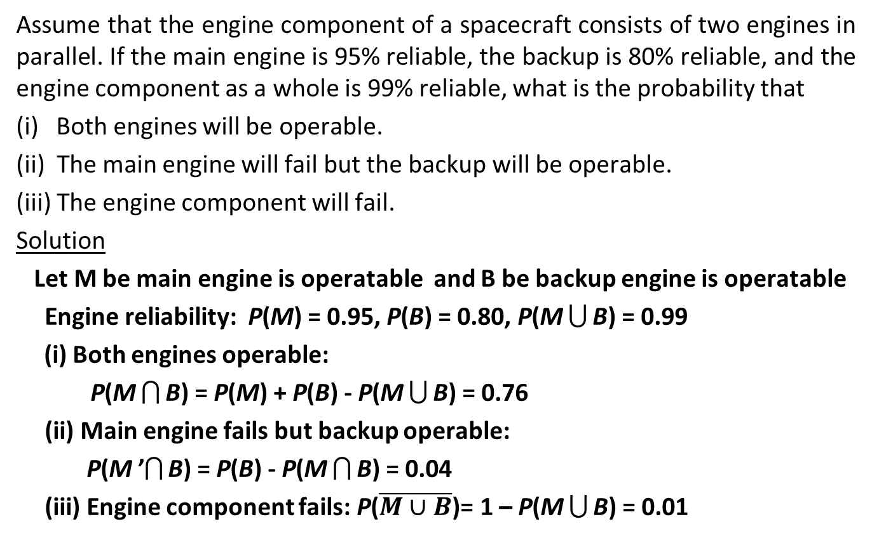
Example 5
Assume that the engine component of a spacecraft consists of two engines in parallel. If the main engine is 95% reliable, the backup is 80% reliable, and the engine component as a whole is 99% reliable, what is the probability that
(i) Both engines will be operable.
(ii) The main engine will fail but the backup will be operable.
(iii) The engine component will fail.
Solution
Let M be main engine is operatable and B be backup engine is operatable
Engine reliability: P(M) = 0.95, P(B) = 0.80, P(M  B) = 0.99
Both engines operable:
P(M  B) = P(M) + P(B) - P(M  B) = 0.76
(ii) Main engine fails but backup operable:
P(M ’ B) = P(B) - P(M  B) = 0.04
(iii) Engine component fails: P($\overline{M∪B}$)= 1 – P(M  B) = 0.01
12

Slide 13
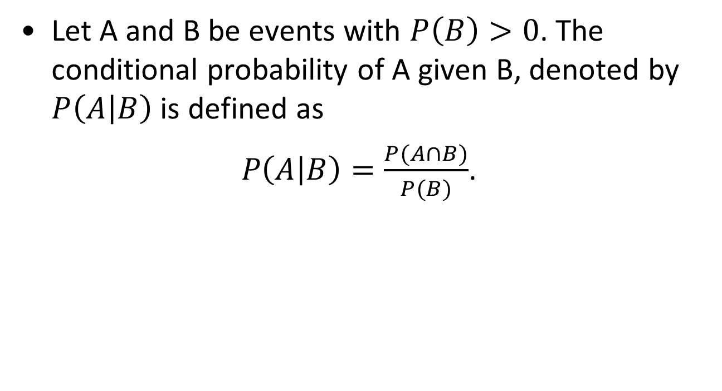
Conditional Probability
Let A and B be events with $P\left(B\right)>0$. The conditional probability of A given B, denoted by $P\left(A | B\right)$ is defined as
$P\left(A | B\right)=\frac{P(A∩B)}{P(B)}$.

Slide 14
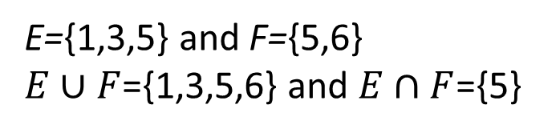
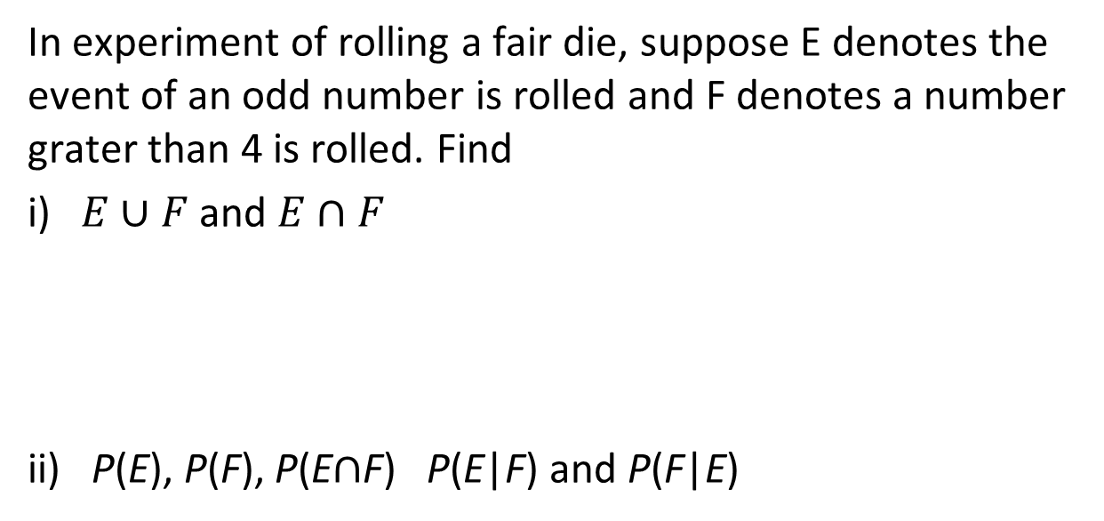
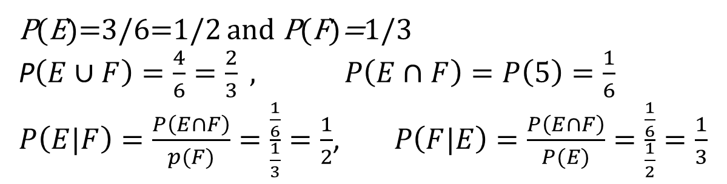
Example 6
In experiment of rolling a fair die, suppose E denotes the event of an odd number is rolled and F denotes a number grater than 4 is rolled. Find
i) $E∪F$ and $E∩F$
ii) P(E), P(F), P(E$∩$F) P(E|F) and P(F|E)
E={1,3,5} and F={5,6}
$E∪F$={1,3,5,6} and $E∩F$={5}
P(E)=3/6=1/2 and P(F)=1/3
P$\left(E∪F\right)=\frac{4}{6}=\frac{2}{3} , P\left(E∩F\right)=P\left(5\right)=\frac{1}{6}$
$P\left(E|F\right)=\frac{P\left(E∩F\right)}{p(F)}=\frac{\frac{1}{6}}{\frac{1}{3}}=\frac{1}{2}$, $P\left(F|E\right)=\frac{P\left(E∩F\right)}{P(E)}=\frac{\frac{1}{6}}{\frac{1}{2}}=\frac{1}{3}$

Slide 15
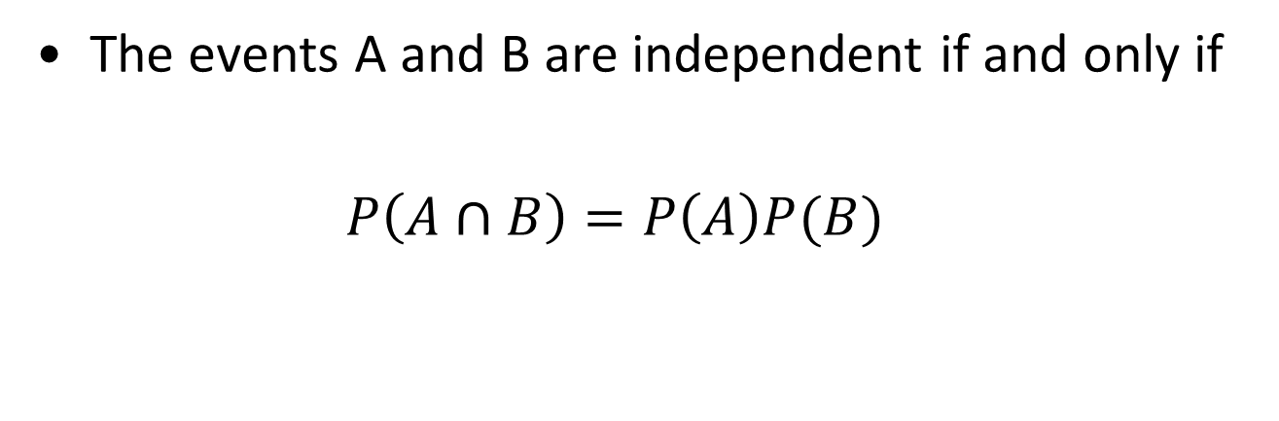
Independence
The events A and B are independent if and only if
$P\left(A∩B\right)=P\left(A\right)P(B)$

Slide 16
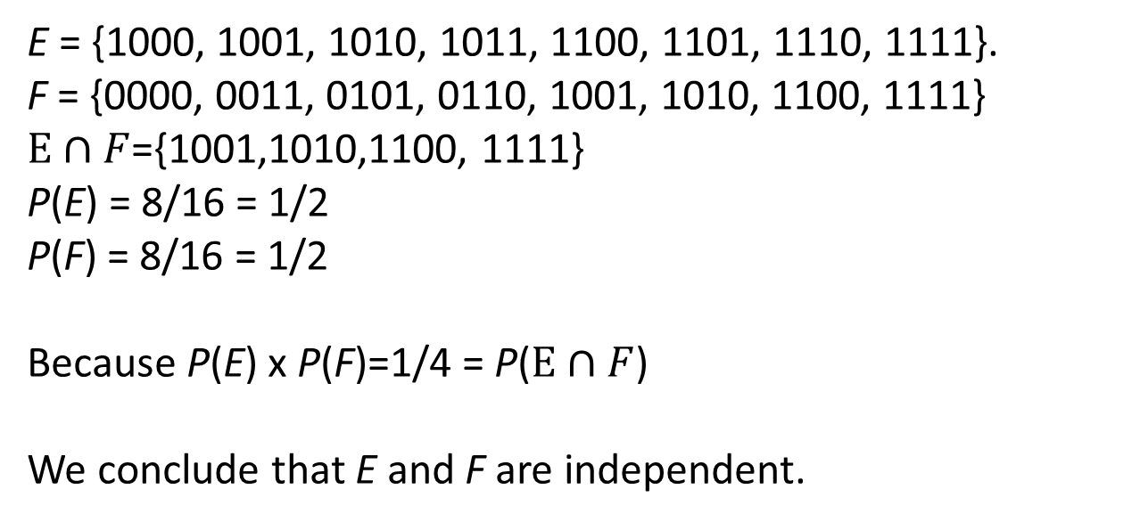
Example 7
Suppose E is the event that a randomly generated bit string of length four begins with a 1 and F is the event that this bit string contains an even number of 1s. Are E and F independent, if the 16 bit strings of length four are equally likely?
Solution
E = {1000, 1001, 1010, 1011, 1100, 1101, 1110, 1111}.
F = {0000, 0011, 0101, 0110, 1001, 1010, 1100, 1111}
$E∩F$={1001,1010,1100, 1111}
P(E) = 8/16 = 1/2
P(F) = 8/16 = 1/2
Because P(E) x P(F)=1/4 = P($E∩F$)
We conclude that E and F are independent.

Slide 17
Representing Conditional Probabilities with a Tree Diagram
We can understand conditional probability better by using a tree diagram.
Tree diagram:
An illustrative way to view conditional probability.
Especially useful for determining probabilities involving events that are not independent.
Conditional probabilities are the probabilities on the second tier of branches.

Slide 18
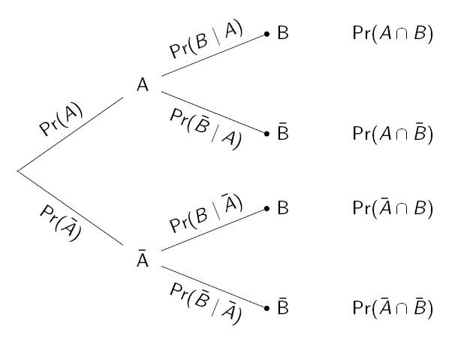




Tree Diagram
Multiply across; add down
$A∩B$ , $P(A∩B)$
$A∩\overline{B}$, $P(A∩\overline{B})$
$\overline{A}∩B$, $P(\overline{A}∩B)$
$\overline{A}∩\overline{B}$, $P(\overline{A}∩\overline{B})$

Slide 19








Tree Diagram
Multiply across; add down
$$A⋂B$$
A
$$A⋂\overline{B}$$
$$\overline{A}⋂B$$
$$\overline{A}$$
$$\overline{A}⋂\overline{B}$$

Slide 20
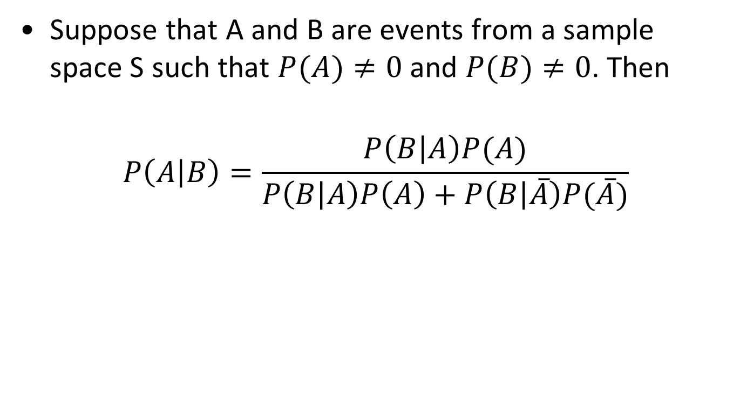
Bayes’ Theorem
Suppose that A and B are events from a sample space S such that $P(A)≠0$ and $P(B)≠0$. Then
$$P\left(A | B\right)=\frac{P\left(B | A\right)P(A)}{P\left(B | A\right)P\left(A\right)+P\left(B | \overline{A}\right)P(\overline{A})}$$

Slide 21
Proof
From the definition of conditional probability we have and
Observe that
Since
Thus

Slide 22
Example 8
A certain disease occurs in mild (denoted as M) or severe form (denoted as S); three-quarter of patients have the mild form. A new drug is available. The probability that a mild case of the disease responds to the drug (P(R|M)) is 0.9, and the probability that a severe case responds (P(R|S)) is 0.5.
(i) What is the probability that a randomly chosen case will respond to the drug, P(R)?
(ii) You are told that a certain patient has responded to the drug. What is the probability that the patient has the mild form of disease, P(M|R) ?

Slide 23
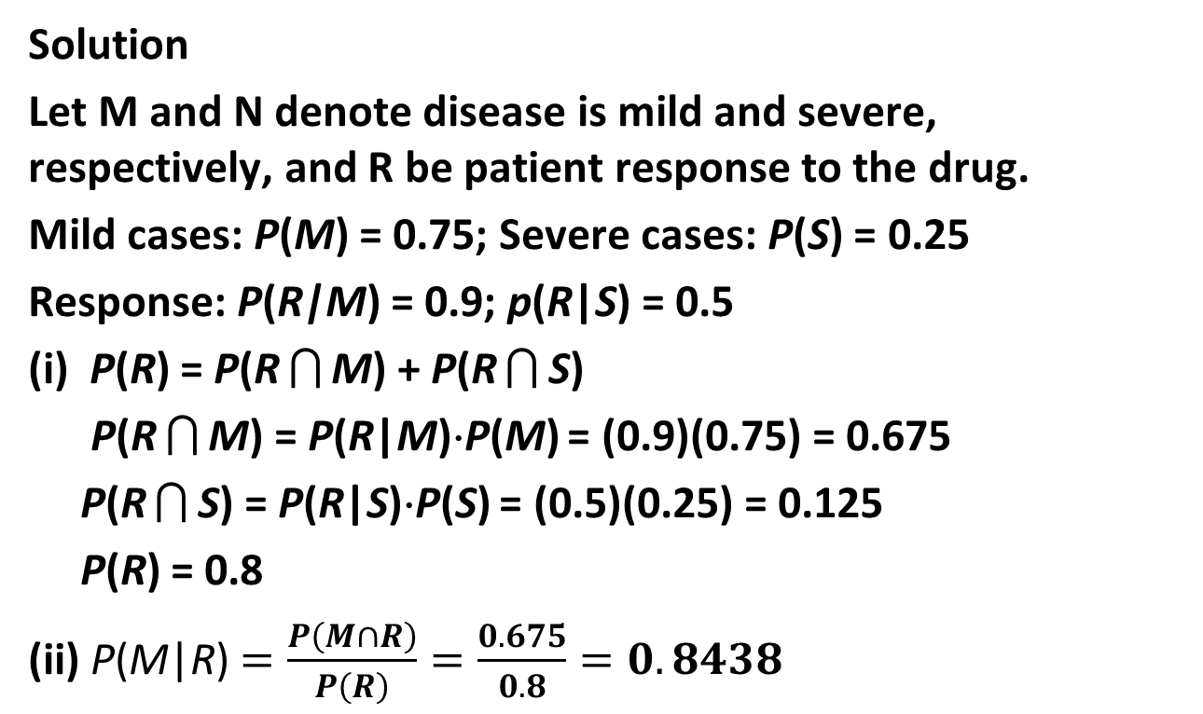
Example 8 (Cont.)
Solution
Let M and N denote disease is mild and severe, respectively, and R be patient response to the drug.
Mild cases: P(M) = 0.75; Severe cases: P(S) = 0.25
Response: P(R|M) = 0.9; p(R|S) = 0.5
(i) P(R) = P(R  M) + P(R  S)
P(R  M) = P(R|M)⋅P(M) = (0.9)(0.75) = 0.675
P(R  S) = P(R|S)⋅P(S) = (0.5)(0.25) = 0.125
P(R) = 0.8
(ii) P(M|R) $=\frac{P\left(M∩R\right)}{P\left(R\right)}=\frac{0.675}{0.8}=0.8438$

Slide 24
Example 8 (Using tree diagram)

Slide 25
Summary
Materials covered in this lecture
Probability theory
Sample space
Event
Mutually exclusive event
Conditional probability
Independent events
Bayes’ Theorem

Slide 26
Exercise 1
An urn contains four blue balls and five red balls. What is the probability that a ball chosen from the run is blue?
26

Slide 27
Exercise 2
A sequence of ten bits is randomly generated. What is the probability that at least one of these bits is 0?
27

Slide 28
Exercise 3
M&M sweets are of varying colors and the different colors occur in different proportions. The table below gives the probability that a randomly chosen M&M has each color, but the value for blue candies is missing.
Find the missing probability.
You draw and M&M at random from a packet. What is the probability of each of the following events?
(i) You get a brown one or a red one.
(ii) You don’t get a yellow one.
(iii) You don’t get either an orange one or a blue one.
(iv) You get one that is brown or red or yellow or green or orange or blue.
Color | Brown | Red | Yellow | Green | Orange | Blue
Probability | 0.3 | 0.2 | 0.2 | 0.1 | 0.1 | ?

Slide 29
Exercise 4
A computer assembling company has two assembly plants, plant S and T. 30% of the company’s products are assembled at plant S, and the remaining 70% at plant T. 5% of computers assembled at plant S and 6% of computers assembled at plant T are defective. A customer bought a computer from this company. Let S and T denote the events that a computer was assembled at plant S and T, respectively. Also, let D be the event that a computer is defective.
1) Find the probability that the computer bought was assembled at plant S and is defective.
2) Find the probability that the computer bought is defective.
3) Find the probability that the computer bought was assembled at plant S given that it is defective.
Notes:
29

